Slide 1
The UK labour market in 2020: what happened?
Andy Durman, Managing Director
Duncan Brown, Senior Economist
11th December 2020

Slide 2
Emsi’s mission is to use labour market data to inform & connect people, education, and employers, within the context of regional economies.

Slide 3
Recruitment: hit hard, but recovering

Slide 4
Labour market: an initial jolt only

Slide 5
Very different from 2008-09

Slide 6
Industries: accommodation hit hard

Slide 7
Furlough: from 1 in 4 to 1 in 12

Slide 8
Industries: different impact, different recovery

Slide 9
State of play: industries

Slide 10
State of play: regions

Slide 12
Who’s facing the risk?

Slide 13
EU workers: going home?

Slide 14
Working from home: the future?

Slide 15
Shopping from home: the future?

Slide 16
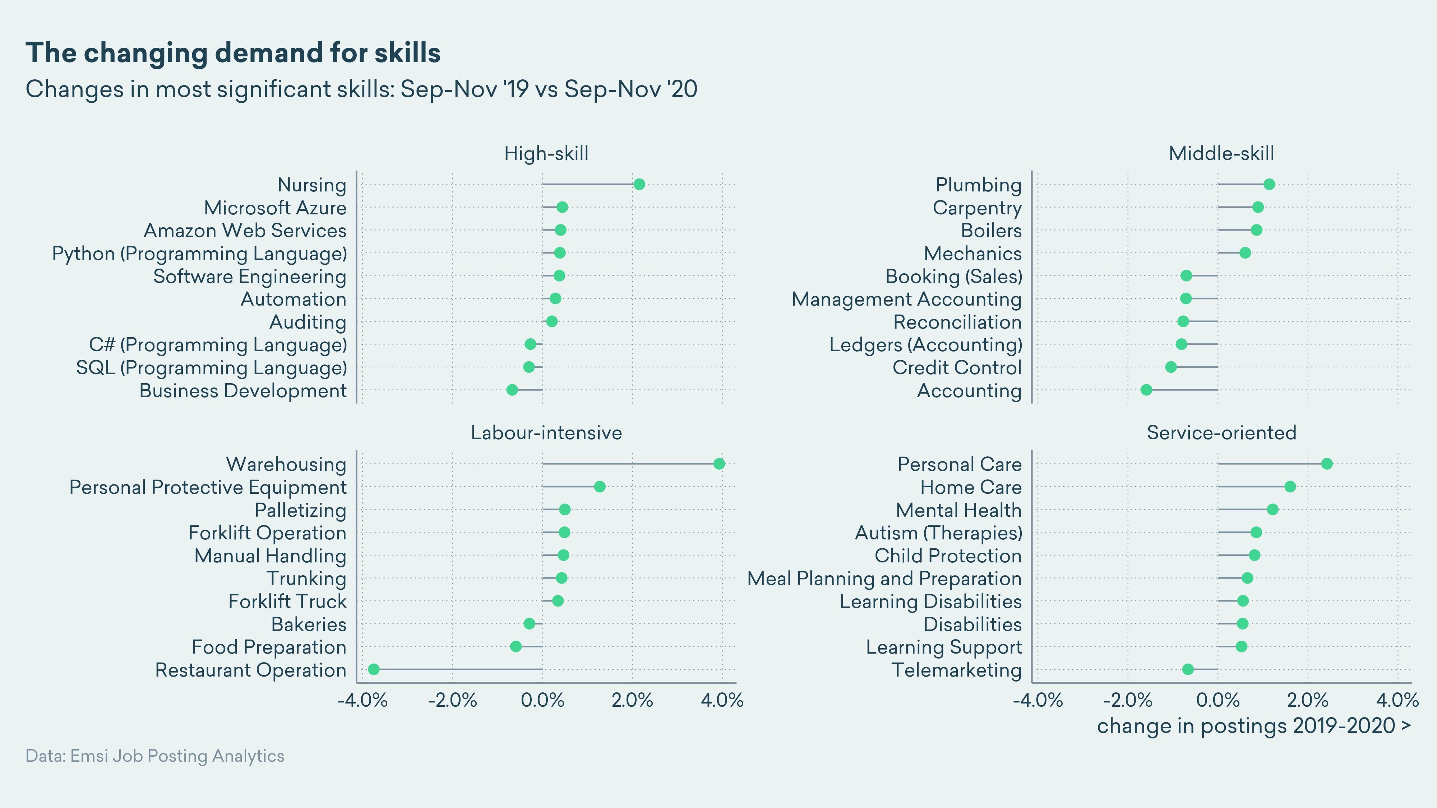

Slide 17
Key messages
As the pandemic hit the UK, recruitment fell sharply but has since recovered somewhat
Unemployment has risen, vacancies have fallen, redundancies have started to icrease – but not as much as we might have feared
Furlough is the main reason why: in the short-term, it seems to have been effective at delaying the decision to shed workers
Industry experiences are very different – but much of the economy has started to move towards recovery, even if slowly, with hotels and restaurants the big exception
Different roles therefore face different risks as we move into 2021, depending on how quickly the economy can be reopened post-vaccine
Workers most affected so far have been young, male and foreign national
In a year of disruptive change, the question will be: how much of it is here to stay, and how much reverts?

Slide 18
Questions for 2021
Will the non-consumer service economy continue recovery sufficient to avoid substantial disruption from the end of furlough?
How quickly will the consumer service economy – hotels, restaurants, arts, entertainment – be able to recover post-vaccine?
How much of the damage of displaced employment is still to be revealed? How long will it take to recover?
Will there be a lasting change in employee and commuter behaviours – working from home, online shopping? What does that mean for jobs?
Will the return of so many migrants – especially from central and eastern Europe – along with legal changes result in a very different migrant labour market in future?
What does Brexit do to all these calculations?

Slide 19
Coming January 2021…
Launch webinar | 14th January 2021 | 14:00 www.economicmodelling.co.uk/webinars/#hot-topics

Slide 20
Thank you and season’s greetings!

